Slide 1


Web Programming 2X1
JS Async

Slide 2
Outcomes
Students should understand the following outcomes, upon successful completion of this module:
Callbacks
Asynchronous
Promises
Async await

Slide 3

Callbacks
A callback is a function passed as an argument to another function, which gets invoked after the main function completes its execution.
You pass the callback function into the main function as an argument, and once the main function finishes its task, it calls the callback function to deliver a result.
JavaScript functions are executed in the sequence they are called. Not in the sequence they are defined.

Slide 4
Callbacks
Real-Life Examples:
1. Loading images on a website:
When you load a website, images can take a while to load, especially if they’re large. If images were loaded synchronously, the website would freeze and wait for each image to load before continuing. With callbacks, you can load the images asynchronously, which means that the website continues to load while the images are being loaded in the background.
2. Handling form submissions:
When a user submits a form, it takes time to process the data and send it to the server. If the form submission was executed synchronously, the user would have to wait for the data to be processed and sent before the form can be submitted. With callbacks, you can handle the form submission asynchronously, which means that the user can continue to interact with the form while the data is being processed and sent in the background.

Slide 5
Why Callbacks?
Callbacks are essential for managing the outcomes of asynchronous tasks without blocking the program’s execution.
Asynchronous tasks, like network requests or database queries, take time to finish.
If these tasks were synchronous, the program would halt until they’re done, resulting in a sluggish user experience.
With callbacks, though, you can keep the program running while these tasks happen in the background. When the task finishes, the callback function handles the result. This ensures the program stays responsive, enhancing the user experience.

Slide 6
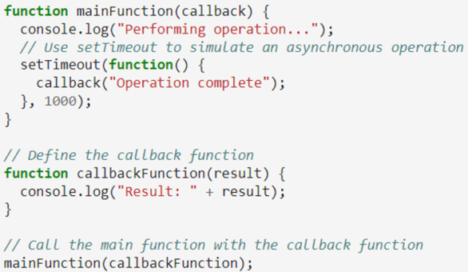
Example
Explanation:
We first define a mainFunction that takes a callback as an argument.
The mainFunction uses setTimeout to simulate an asynchronous operation. The setTimeout function takes two arguments: a callback function and a delay time in milliseconds.
The setTimeout function calls the callback function with the result of the operation after the specified delay time.
We then define a callbackFunction that logs the result of the operation.
Finally, we call the mainFunction with the callbackFunction as its argument.
Notes:
Output >>
Performing operation...
Result: Operation complete

Slide 7
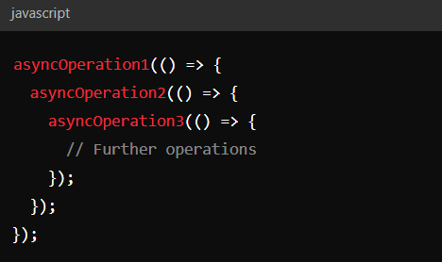
Callback Hell
Asynchronous operations requiring multiple steps can lead to nested callbacks, making the code hard to read and maintain.
For example:

Slide 8
Advantages:
Simple and easy to understand for small operations.
Effective for executing code in order.
Disadvantages:
Callback Hell: Nested callbacks can lead to code that is difficult to read and maintain.
Error Handling: Managing errors across multiple callback levels can be cumbersome.

Slide 9
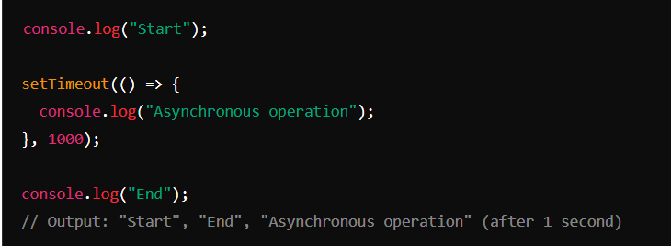
Asynchronous Operations
Asynchronous programming allows code to run without blocking the main execution thread. This is useful for operations like network requests, file reading/writing, or timers.
An asynchronous model allows multiple things to happen at the same time. When you start an action, your program continues to run. When the action finishes, the program is informed and gets access to the result (for example, the data read from disk).
Example - Using setTimeout to mimic an asynchronous operation:

Slide 10
Why Use Asynchronous Operations?
Non-Blocking: Prevents the application from freezing or becoming unresponsive while waiting for operations like network requests, file reading/writing, or timers.
Efficiency: Allows other tasks to be performed while waiting for an asynchronous task to complete.

Slide 11
Promises
A Promise is an object that represents the eventual completion (or failure) of an asynchronous operation and its resulting value.
A promise can be in one of three states:
Pending: Initial state, neither fulfilled nor rejected.
Fulfilled: Operation completed successfully.
Rejected: Operation failed.
A promise starts in the pending state which indicates that the promise hasn’t completed. It ends with either fulfilled (successful) or rejected (failed) state.

Slide 12
When you work with promises, you are either a producer of a promise object, or a consumer.
Producing a Promise (using the Promise Constructor)
(1)>> Producer Promise
const p = new Promise( function (resolve, reject) { // (A)
···
if (···) {
resolve(value); // success
}
else {
reject(reason); // failure
}
});
Notes:
Explanation:
Resolving: If the computation went well, the executor sends the result via resolve(). That usually fulfills the Promise
Rejecting: If an error happened, the executor notifies the Promise consumer via reject(). That always rejects the Promise.

Slide 13
(2)>> Consuming a Promise
As a consumer of promise, you are notified of a fulfillment or a rejection via reactions
– callbacks that you register with the methods .then() and catch():
Code:
promise
.then(value => { /* fulfillment */ })
.catch(error => { /* rejection */ });

Slide 14
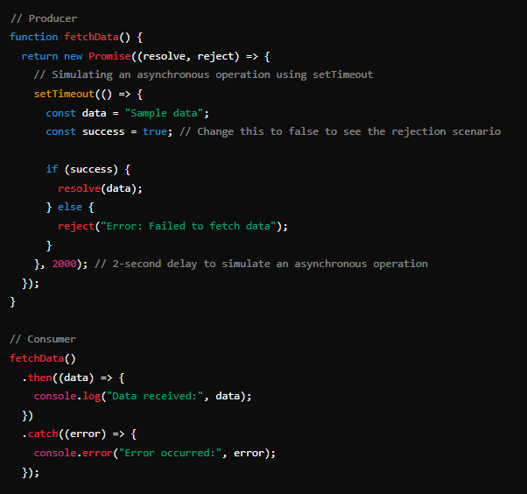
Example of Promises:
Notes:
Explanation
Producer (fetchData function): This function returns a new Promise. Inside the promise, an asynchronous operation is simulated using setTimeout. After 2 seconds, the operation either resolves with some data or rejects with an error message based on the success variable.
Consumer (fetchData().then().catch()): This part of the code calls the fetchData function and uses the .then() method to handle the resolved value (data) and the .catch() method to handle any errors that occur (if the promise is rejected).

Slide 15
Advantages:
Chaining: Promises can be chained to handle multiple asynchronous operations in sequence.
Error Handling: Easier to handle errors using .catch
Disadvantages:
Can still become complex with multiple nested then calls.

Slide 16
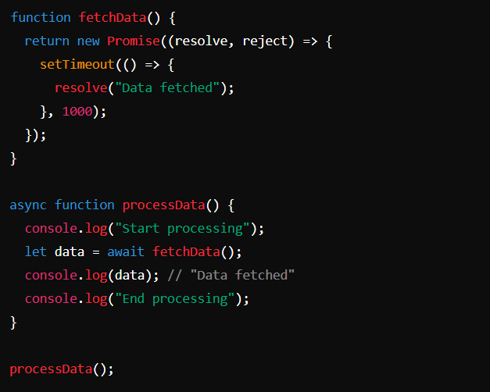
Async/Await
async/await is syntactic sugar built on promises that allows you to write asynchronous code in a more synchronous-looking manner.
Example:

Slide 17
Advantages:
Readability: Makes asynchronous code look more like synchronous code, improving readability.
Error Handling: Easier error handling using try/catch.
Disadvantages:
Requires understanding of both promises and async/await syntax.
Still requires managing promise rejections properly.

Slide 18
Summary
Callbacks are simple but can lead to callback hell.
Asynchronous operations allow code to run without blocking the main thread
Promises provide a cleaner way to handle asynchronous operations and avoid callback hell.
Async/Await offers a more readable and maintainable way to write asynchronous code, making it look more like synchronous code.

Slide 19
Thank You!
The End
/belgiumcampusSA
#Belgium Campus
info@belgiumcampus.ac.za
+27 10 593 53 68
/belgiumcampus

